Slide 1



MODULE 4
The Creative Global Marketing Plan
www.icciproject.com

Slide 2
STRUCTURE-RELATED FEATURES OF THE CCI
¬ usually freelancers or small companies (< 10 people)
¬ Pioneers of new business models (profit, non-profit, interlinked models)
¬ Interconnectivity of the artistic & cultural production sphere
¬ high decision level to start a business, high company closing

Slide 3
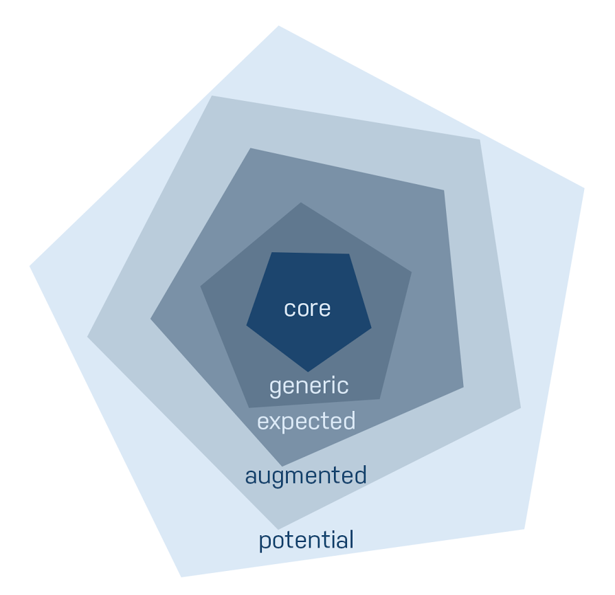
5 Levels of
a Product
Notes:
Benefit, warmth
fit rain
warm comfortable
known brand, warranty core - generic, maybe expected
intangible
customer relation
intrinsic wish to create
wavelength
we know what you have - what goals do you want …

Slide 4
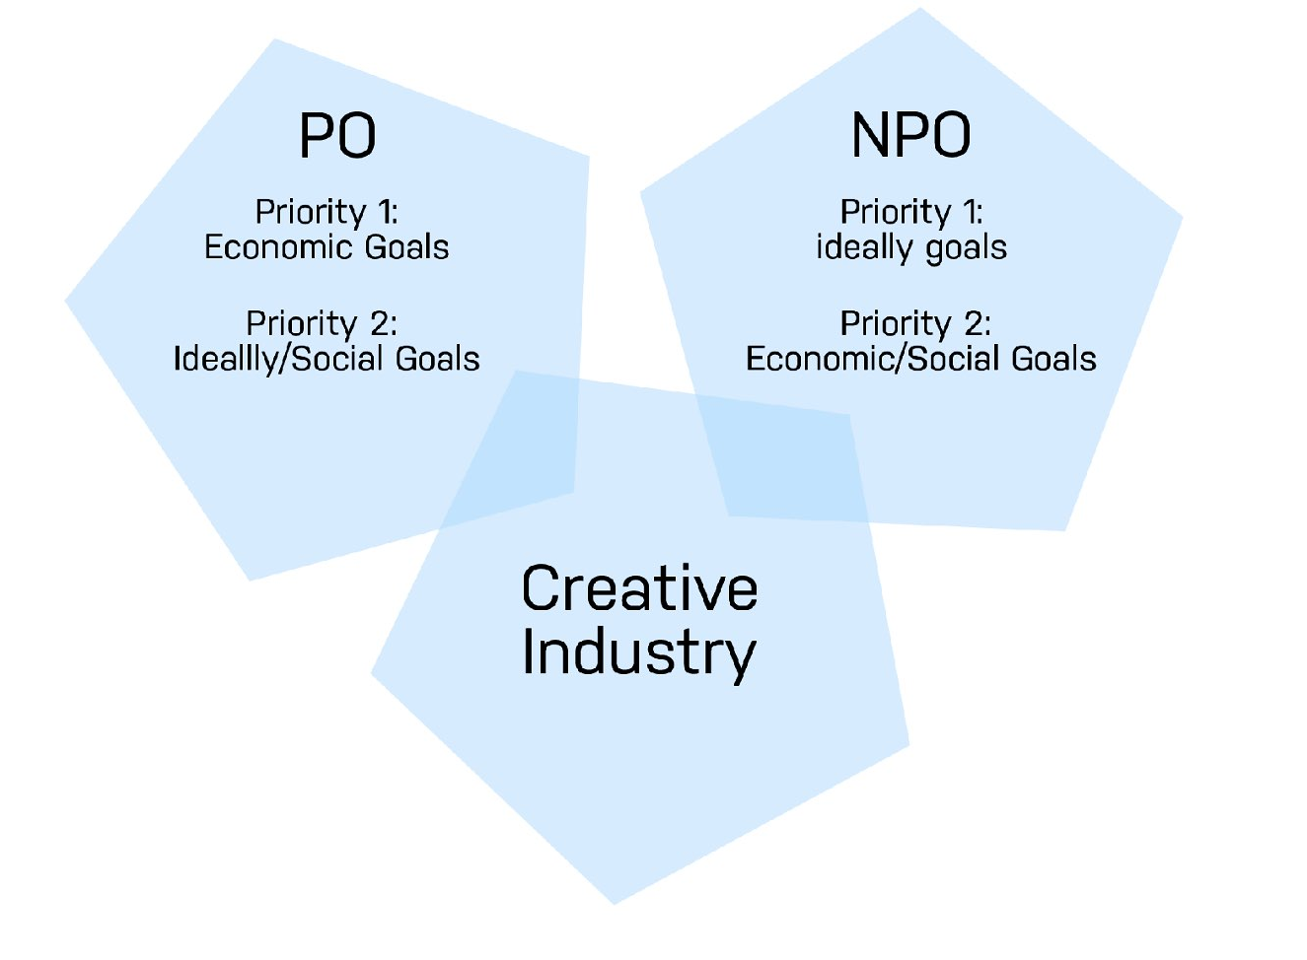
Target system
in the CCI
Notes:
- content-driven
conduct co-design-process of our society.
Economic goals:
profit orientation, profit maximisation, increase or maximisation of the market share, cost coverage, cost reduction, revenue maximisation, and the like.
Ideally goals:
realisation of an idea, creation of attention for a theme, realisation of a vision, etc. , independent of the economic orientation
Social goals:
- the creation and maintenance of employment, good social conditions for employees and suppliers, as well as the reduction of environmental emissions by the company and others, reduction of the carbon footprint.

Slide 5
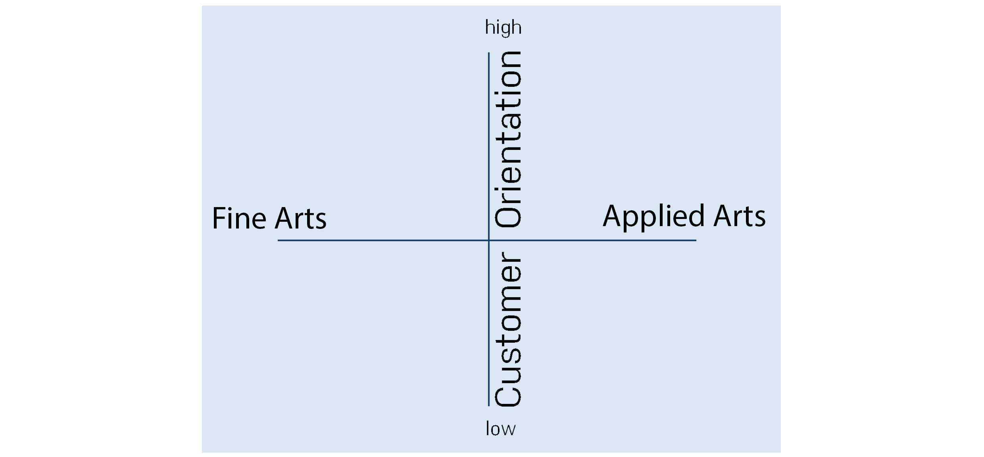
Notes:
test a new tool to get a self-reflection, where you stand

Slide 6

MARKETING
Notes:
stomach feeling
nothing to be afraid of
marketing does not use you, but you should use it
„Strategic marketing is about finding customers who are on your wavelength – then selling to them is easy and natural, not a painful process“ (David Parrish)

Slide 7
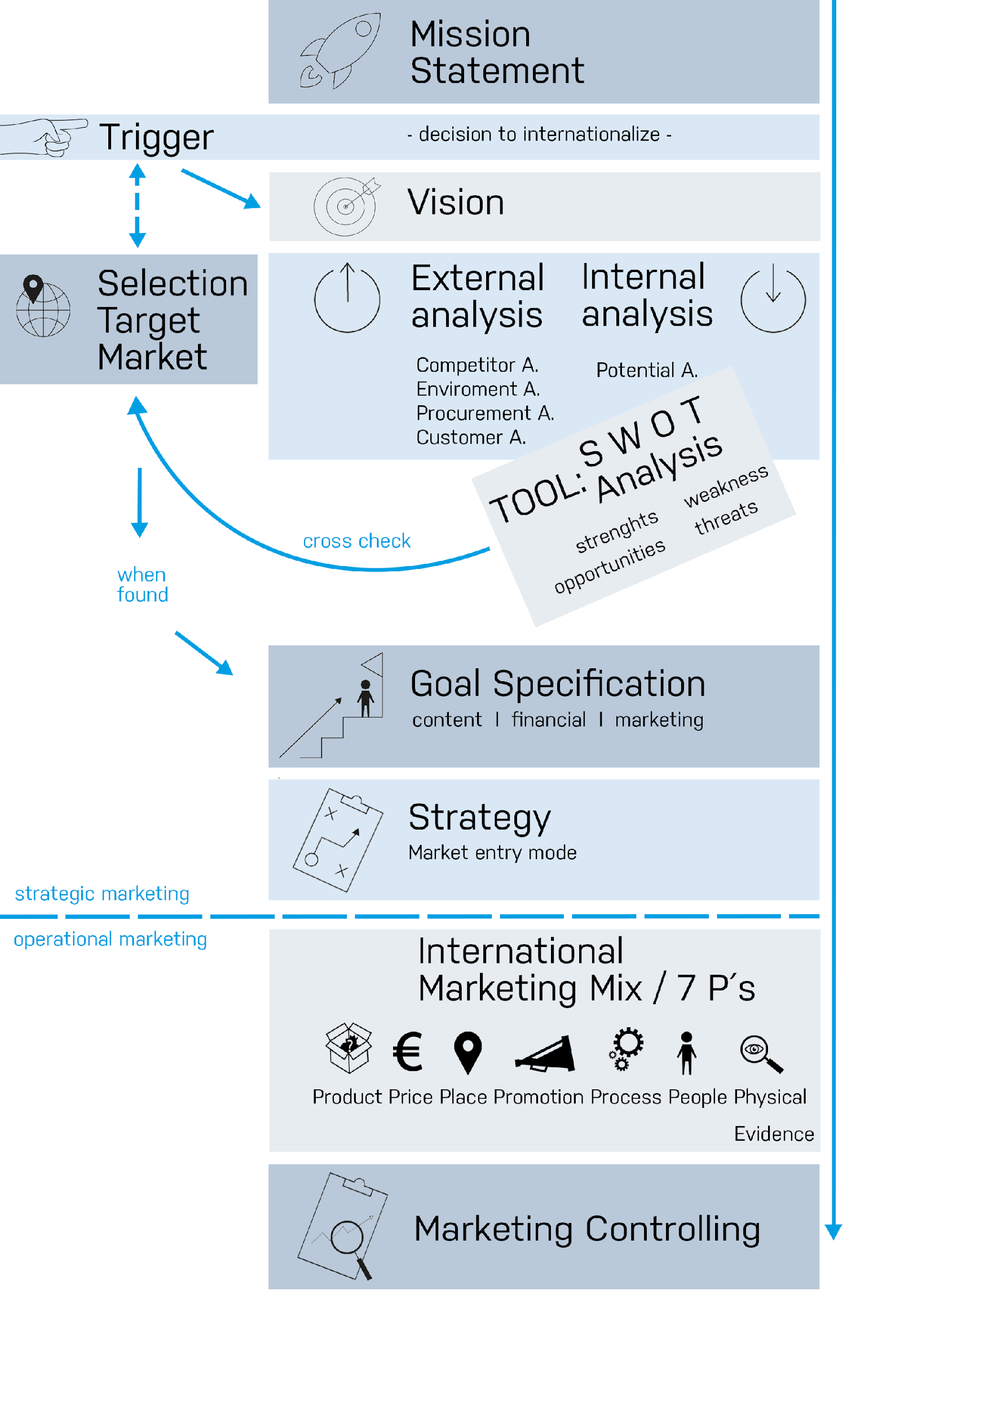
International
marketing plan
Notes:
“Don’t be a busy fool. Slow down and think; work smart, not hard. Think strategic marketing first.” as the author Parrish says.

Slide 8
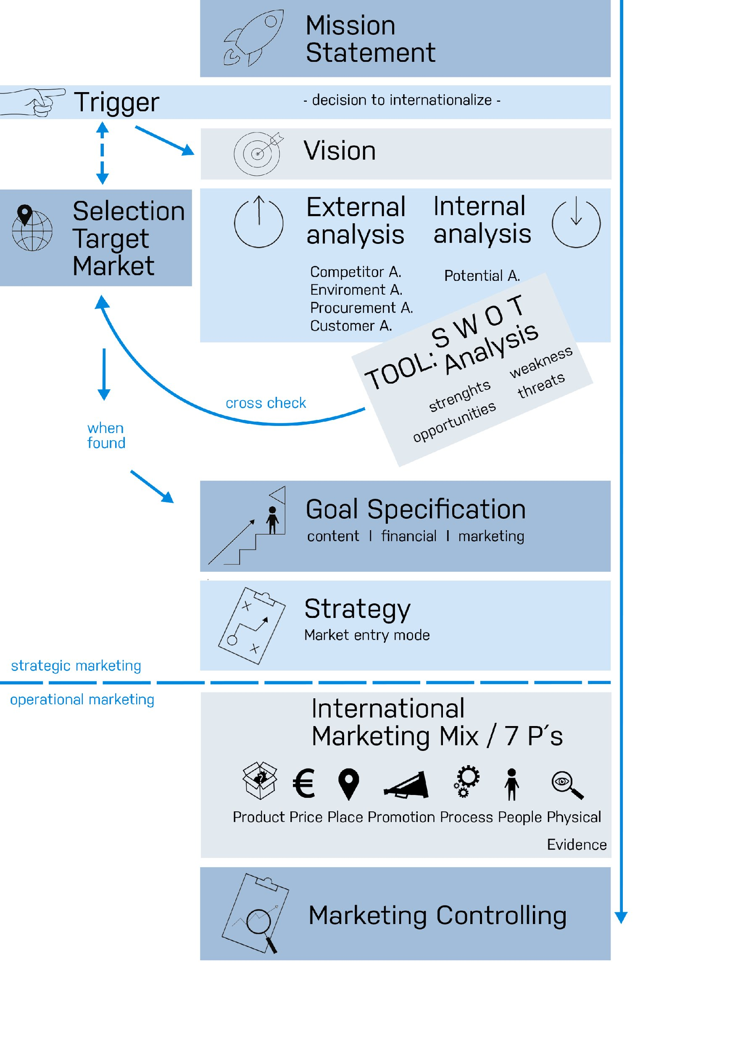
¬ An ultimate goal to which the rest of your target system must be subordinated!
¬ Determines the clear intention of your company.
¬ The purpose of your company is summarised in the so-called mission statement.
¬ The mission statement must be generally comprehensible and brief.
Notes:
Let’s start!
Before starting an internationalize, you have to develop your mission.
Mission
The first and most crucial question is a clear and precise definition of your mission. This is the most fundamental decision, that you have to take
IMPORTANT: You should not mix up the mission statement with a commercial slogan or even a motto!

Slide 9
Mission Statement:
Examples
Pixar (Entertainment) “Pixar’s objective is to combine proprietary technology and world-class creative talent to develop computer-animated feature films with memorable characters and heartwarming stories that appeal to audiences of all ages.”
BO-Design (Furniture Design) “Through passionate and persistent performance we make customised and coordinated design furniture and accessories affordable to the urban-minded customer.“

Slide 10
¬ Where do we have to go?
¬ How do we have to develop further?
¬ How can we secure existence and growth?
¬ What are we dealing of?
“A vision should be a picture of the future, close enough that the feasibility can still be seen, but already far enough to arouse the enthusiasm of your company for a new reality.”

Slide 11
BO-Design (Furniture Design) „To make BoConcept no. 1 brand within urban interiors.“

Slide 12
Time to analyse!
Notes:
After your decision to internationalise and your selection of the target market, it is time to analyse this target market!
Which fields should be analysed with regard to your selected target market?
(USE A FLIPCHART and match the results with this overview)
External Analysis
Competitor Analysis
Environment Analyses
Technical forces
Demographic
Economic forces
Socio-cultural forces
Political and legal forces
Costumer Analysis (where and who are they?)
Procurement Analysis (where can you find you partners, funding, personal?)
Internal Analysis
Potential Analysis: Identify your competences (with regard to your target market)

Slide 13
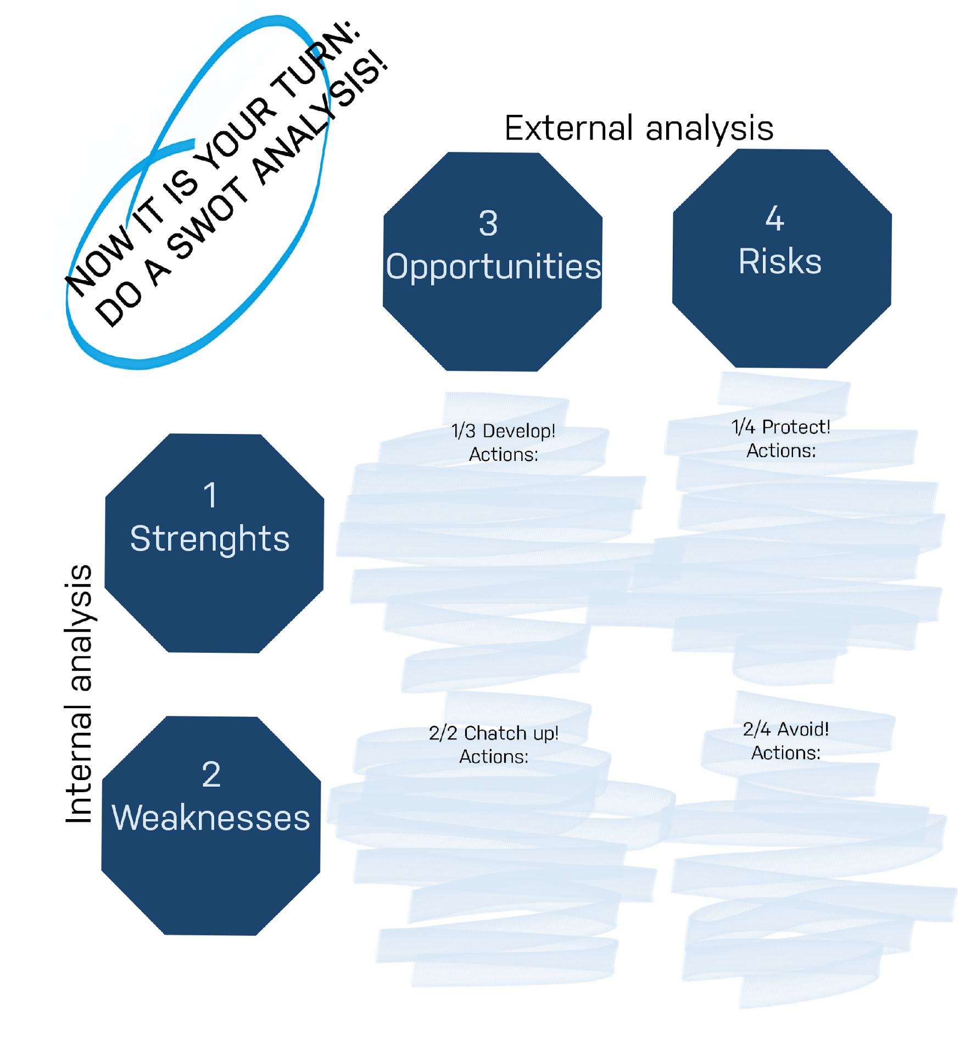
SWOT
analysis
Notes:
The SWOT-analysis is a connection between (internal) potential analysis and (external) environmental development analysis.
The objective of using this tool is to find the right match between the internal (your strenghts and weaknesses) and external analysis (opportunities and risk), for example where in the market can I use my special competences?
ACTIONS: DEVELOP, Protect, Catch up and avoid and the according actions.
Strengths (internal and external perspective)
What advantages do you have?
What do you do better than anyone else?
What do people in your market see as your strengths?
What is your organization's Unique Selling Proposition
(USP)?
Weaknesses (internal and external perspective)
> What could you improve?
> What should you avoid?
> What are people in your market likely to see as weaknesses?
Opportunities
> What good opportunities can you spot?
> What interesting trends are you aware of?
Useful opportunities can come from such things as:
>Changes in technology and markets on both a broad and narrow scale.
>Changes in government policy related to your field.
> Changes in social patterns, population profiles, lifestyle changes, and so on.
> Local events.
Tip:
A useful approach when looking at opportunities is to look at your strengths and ask yourself whether these open up any opportunities. Alternatively, look at your weaknesses and ask yourself whether you could open up opportunities by eliminating them.
Risks
What obstacles do you face?
What are your competitors doing?
Are quality standards or specifications for your job, products or services changing?
Is changing technology threatening your position?
Do you have bad debt or cash-flow problems?
Could any of your weaknesses seriously threaten your business?

Slide 14
From Mission to your specific market goals
Notes:
We have come very far, most if the main question have been asked, some are left!
After formulating your mission, vision and finding your target market, it is time to set up your specific goals, that you want to achieve in your selected target market.
> You have to specify your content, marketing and financial goals for each country, you want to enter.
> Content goals
What should be achieved?
> Marketing goals (impact)
who should be reached with the content goals and with what effects?
quantifiable marketing variables (measurable)
marketing psychological goals (not easily measurable)
Financial goals
Revenue, income, cost coverage, ...

Slide 15
From the mission to your strategy
Notes:
WE TALKED ABOUT THIS IN ANOTHER MODULE
For now its important to understand that this is the part where you match your strategic findings with operational tools. or in other words:
Marketing strategies represent the hinge between the marketing objectives ("What do you want to achieve?") and the marketing tools ("What instruments should be used to achieve these goals?“).

Slide 16



Slide 17
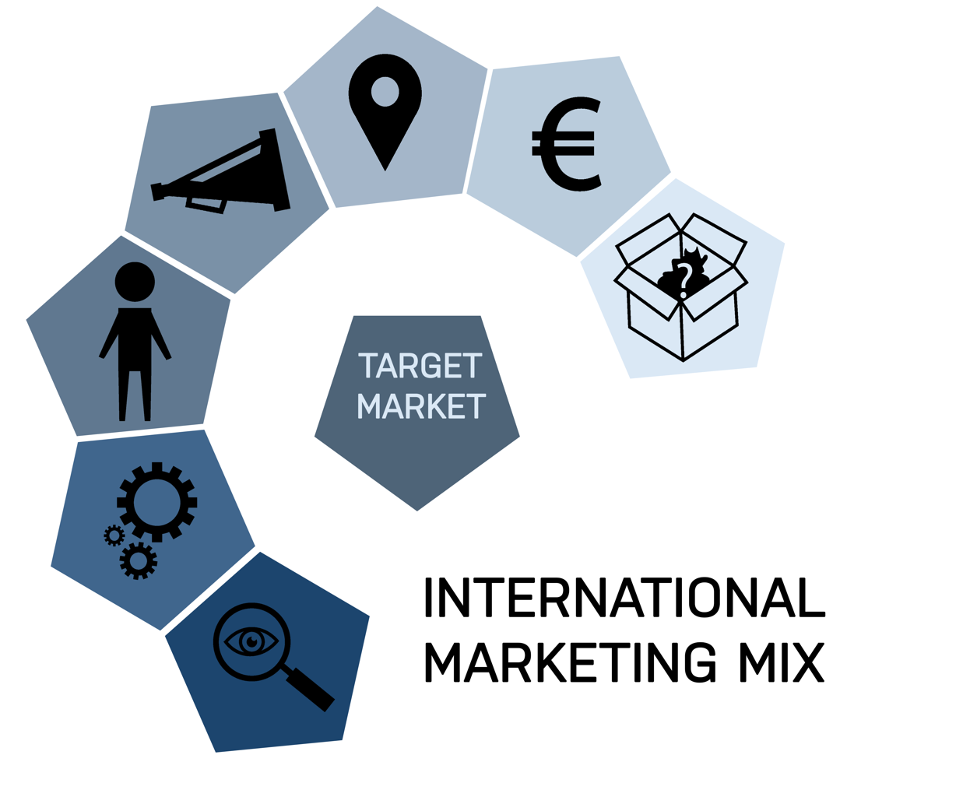

Slide 18

¬ Tangible/Intangible/service
¬ 5 product levels
¬ product life cycle/timing

Slide 19

¬ customers´point of view
¬ competative
¬ augmented product level
Notes:
extern:tarriffs,retail enviroment, distribution structure, exchange rates
goals and cost

Slide 20

¬ real & virtual
¬ appropriate place
¬ whole process
Notes:
display
Mobile channel
consumtion habits

Slide 21
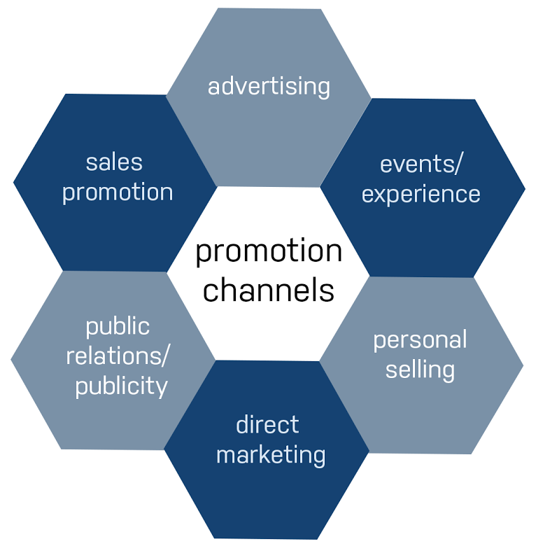
Notes:
Advertising: Print &amp; Broadcast, Ads, Posters…
● Sales promotion: Premium, Gifts, Fairs, Exhibits...
● Events/Experience: Festivals, Street activities ...
● Public Relations &amp; Publicity: Newsletter, Seminars, Annual reports…
● Personal selling: Sales presentations, Meetings…
● Direct marketing: Catalogues…
website /linked in
consumption habits
pro

Slide 22
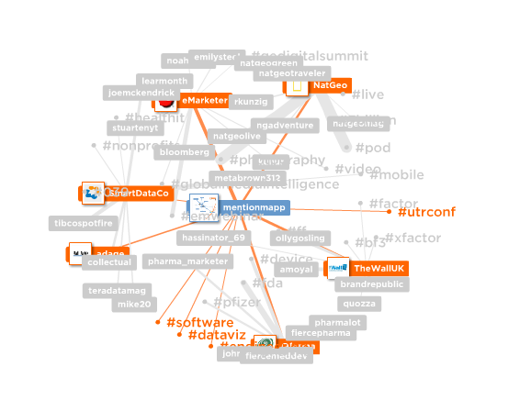
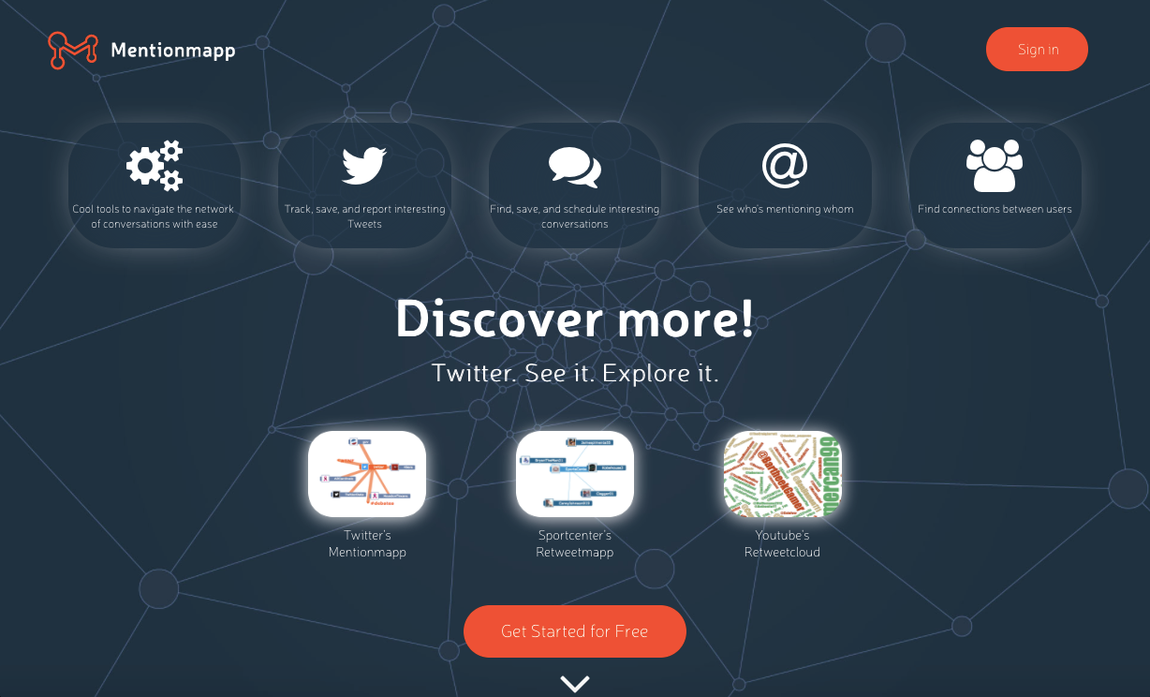

Slide 23
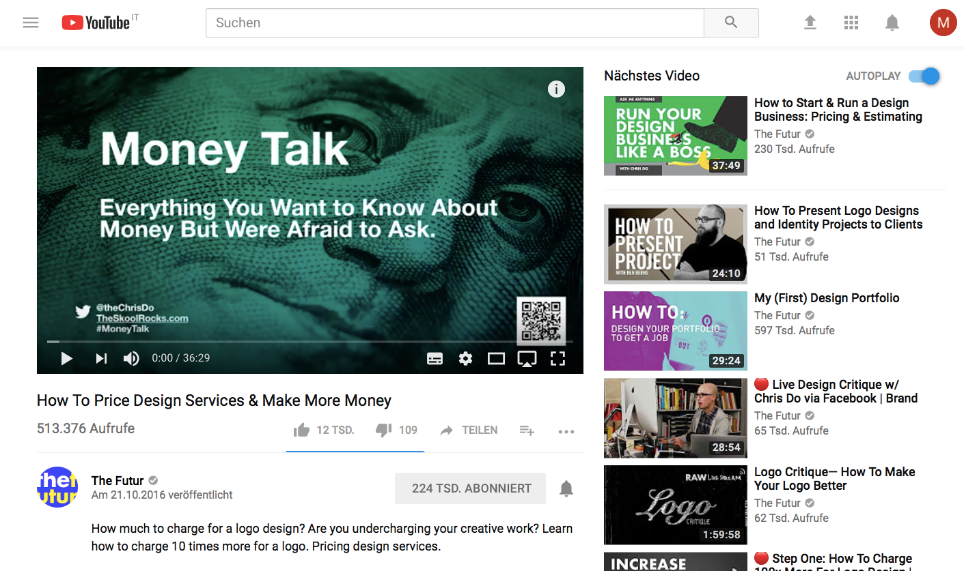
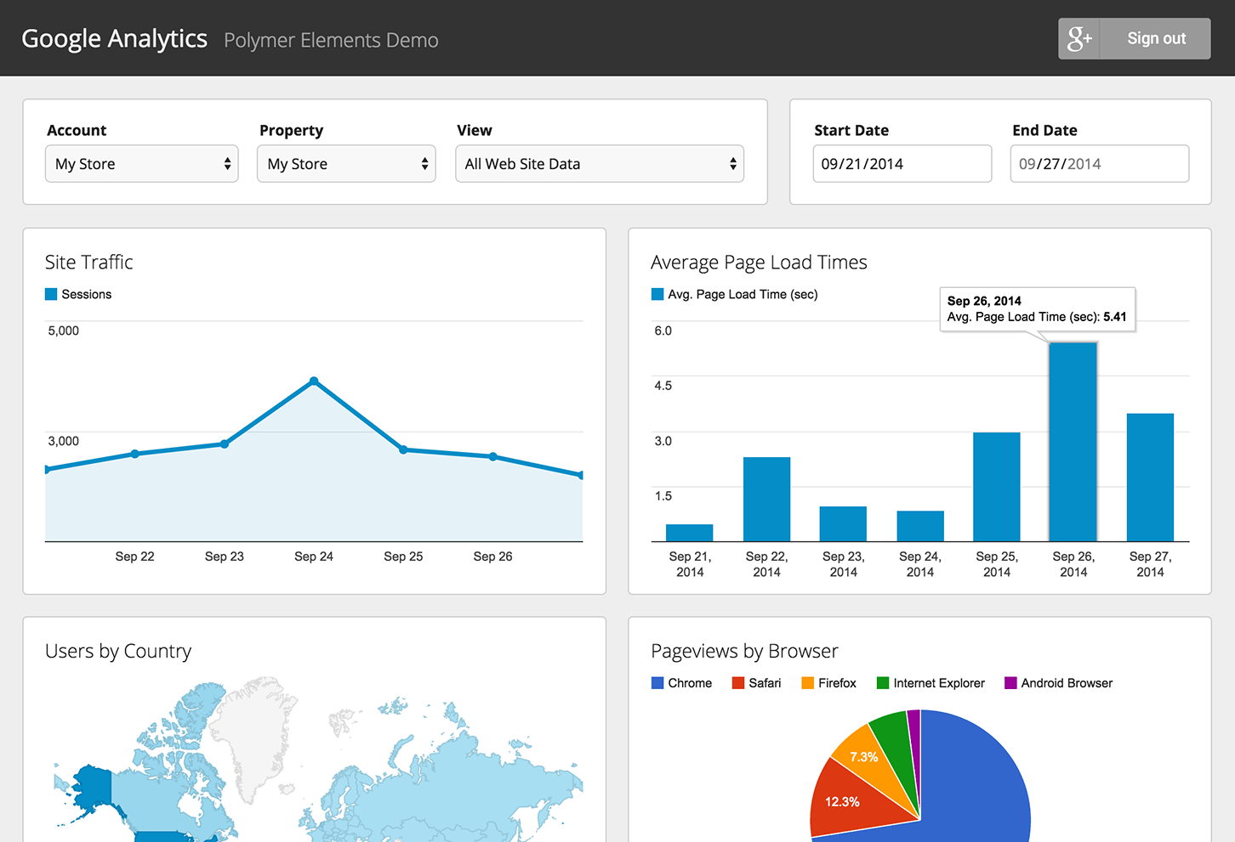

Slide 24

¬ representation
¬ support
¬ reviews
Notes:
people
reputation
aber support
reviews

Slide 25

¬ interface
¬ experience
¬ customer journey
Notes:
interface
reassurance
invest into experience
authentic feedback

Slide 26

¬ reduce customers risk
¬ reference material
¬ permises
Notes:
permises
ref material
testimonials
risk reduction

Slide 27
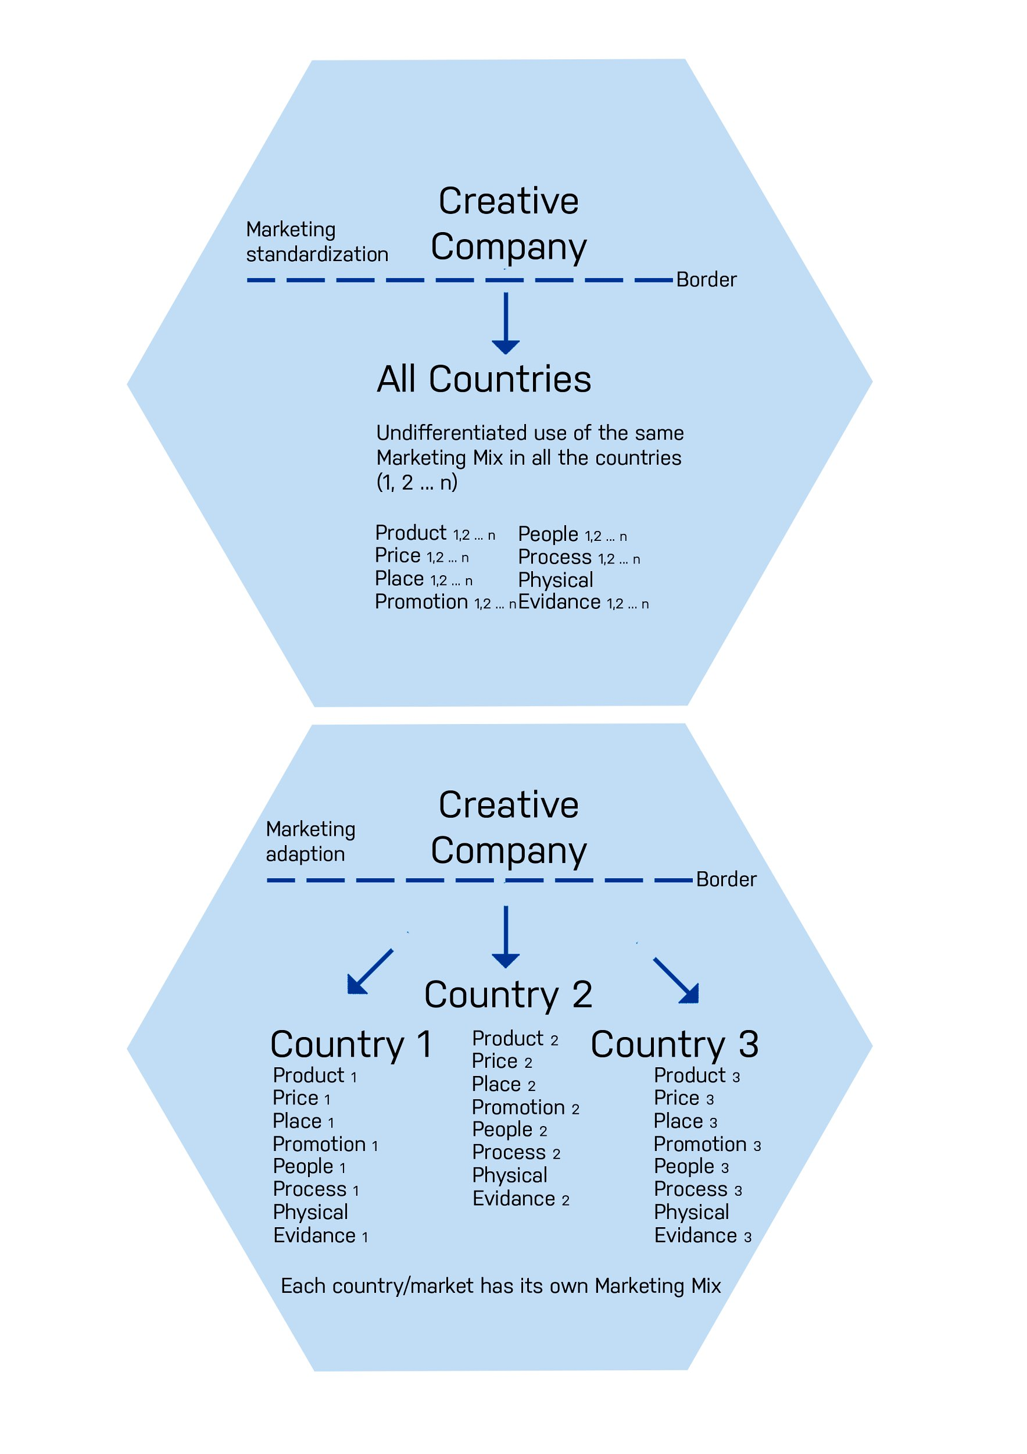
Notes:
a standardised, global marketing approach or a country-specific, differentiated marketing approach?
But on a concrete operational level, if we will question your marketing-mix, you will discover, that it is relevant to you in terms of the degree to which you should standardise or adapt your International marketing mix.

Slide 28


Christiana van Osenbrüggen & Milica Jojevic
City of Gelsenkirchen, Germany
www.icciproject.com
facebook.com/ICCIProject/
Icci_project

